Slide 1
Linear Prediction Modeling and Model Assessment

Slide 2
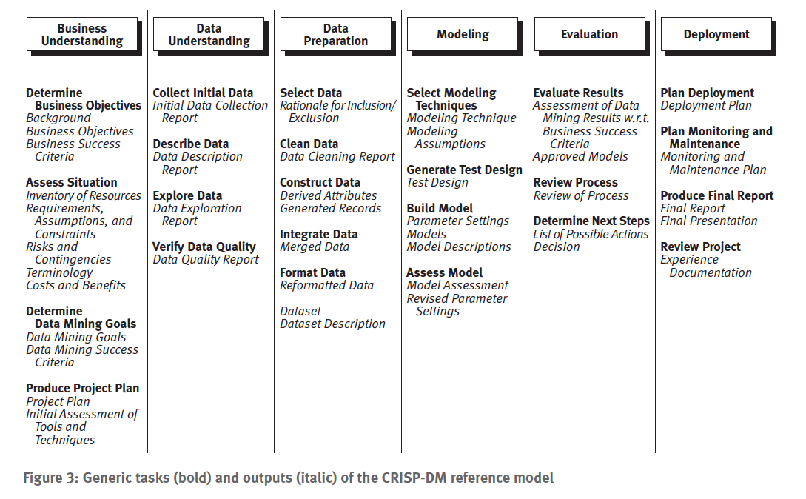
CRISP-DM Data Mining Model
We are discussing Modeling for the first time
Source: CRISP-DM 1.0 Guide from SPSS.com. Also see www.crisp-dm.org

Slide 3
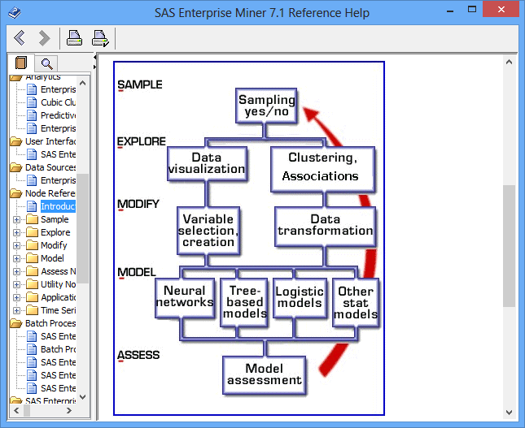
SEMMA Process
Source: SAS Enterprise Miner help

Slide 4
Evaluating the Accuracy of a Classifier or Predictor (I) – Dataset Partitioning
(pp. 370-371 in textbook)
Holdout method – Sample Tab Data Partition Node in EMiner
  Given data is randomly partitioned into two independent sets
    Training set (e.g., 2/3) for model construction
    Test set (e.g., 1/3) for accuracy estimation (Note EM calls this set the validation set)
  Random sampling: a variation of holdout
    Repeat holdout k times, accuracy = avg. of the accuracies obtained
Cross-validation (k-fold, where k = 10 is most popular)
  Randomly partition the data into k mutually exclusive subsets, each approximately equal size
  At i-th iteration, use D_{i} as test set and others as training set
  Leave-one-out: k folds where k = # of tuples, for small sized data
  Stratified cross-validation: folds are stratified so that class dist. in each fold is approx. the same as that in the initial data

Slide 5
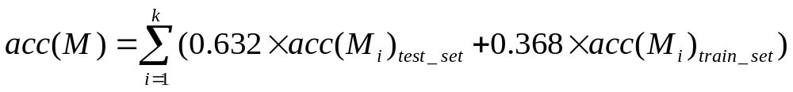
Evaluating the Accuracy of a Classifier or Predictor (II) - Dataset Partitioning
Bootstrap
  Works well with small data sets
  Samples the given training tuples uniformly with replacement
    i.e., each time a tuple is selected, it is equally likely to be selected again and re-added to the training set
Several boostrap methods, and a common one is .632 boostrap
  Suppose we are given a data set of d tuples. The data set is sampled d times, with replacement, resulting in a training set of d samples. The data tuples that did not make it into the training set end up forming the test set. About 63.2% of the original data will end up in the bootstrap, and the remaining 36.8% will form the test set (since (1 – 1/d)^{d} ≈ e⁻¹ = 0.368)
  Repeat the sampling procedue k times, overall accuracy of the model:

Slide 6
Classification vs. Prediction
Classification - Will see soon
  predicts categorical class labels (discrete or nominal)
  classifies data (constructs a model) based on the training set and the values (class labels) in a classifying attribute and uses it in classifying new data
Prediction
  models continuous-valued functions, i.e., predicts unknown or missing values
Typical applications
  Credit approval
  Target marketing
  Medical diagnosis
  Fraud detection
Data Mining: Concepts and Techniques

Slide 7
What Is (Numerical) Prediction?
(Numerical) prediction is similar to classification
  construct a model
  use model to predict continuous or ordered value for a given input
Prediction is different from classification
  Classification refers to predict categorical class label
  Prediction models continuous-valued functions
Major method for prediction: regression
  model the relationship between one or more independent or predictor (X) variables and a dependent or response (Y) variable
Regression analysis
  Linear and multiple regression
  Non-linear regression
  Other regression methods: generalized linear model, Poisson regression, log-linear models, regression trees
Data Mining: Concepts and Techniques

Slide 8
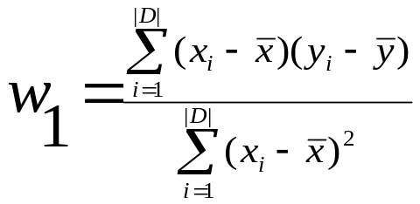
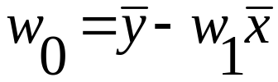
Linear Regression Review
Linear regression: involves a response variable y and a single predictor variable x
    y = w₀ + w₁ x
  where w₀ (y-intercept) and w₁ (slope) are regression coefficients
Method of least squares: estimates the best-fitting straight line
Multiple linear regression: involves more than one predictor variable
  Training data is of the form (X₁, y₁), (X₂, y₂),…, (X_{|D|}, y_{|D|})
  Ex. For 2-D data, we may have: y = w₀ + w₁ x₁+ w₂ x₂
  Solvable by extension of least square method or using Modeler
  Many nonlinear functions can be transformed into the above
Data Mining: Concepts and Techniques

Slide 9
Linear Regression Example
Assumptions for Linear Regression
(i) linearity of the relationship between dependent and independent variables
(ii) independence of the errors (no serial correlation)
(iii) homoscedasticity (constant variance) of the errors
(a) versus time
(b) versus the predictions (or versus any independent variable)
(iv) normality of the error distribution.
Source: http://www.duke.edu/~rnau/testing.htm
http://www.statsoft.com/textbook/multiple-regression/#assumptions also has a nice write-up on this

Slide 10
Multicollinearity in Multiple Linear Regression
See http://www.graphpad.com/support/faqid/1768/
Multicollinearity occurs when two or more predictor variables are correlated to each other
This does not affect predictions, but does affect interpretation of predictor variables (x’s) affect on target variable (y)
  Important variables may not be signficant
  Confidence intervals may be very wide
We will use correlation tests, graphs, and Regression Node to detect and eliminate multicollinearity

Slide 11
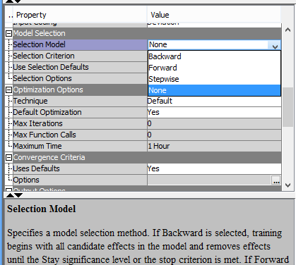
3 Types of Linear Node Model Selection
Selection Model — Use the Selection Model property of the Regression node to specify the model selection method
that you want to use during training. You can choose from the following effect selection methods:
  Backward — begins with all candidate effects in the model and removes effects until the Stay Significance Level or the Stop Criterion is met.
  Forward — begins with no candidate effects in the model and adds effects until the Entry Significance Level or the Stop Criterion is met.
  Stepwise — begins as in the forward model but may remove effects already in the model. Continues until Stay Significance Level or Stepwise Stopping Criteria are met.
  None — (default setting) all inputs are used to fit the model.
Source: EMiner Help

Slide 12
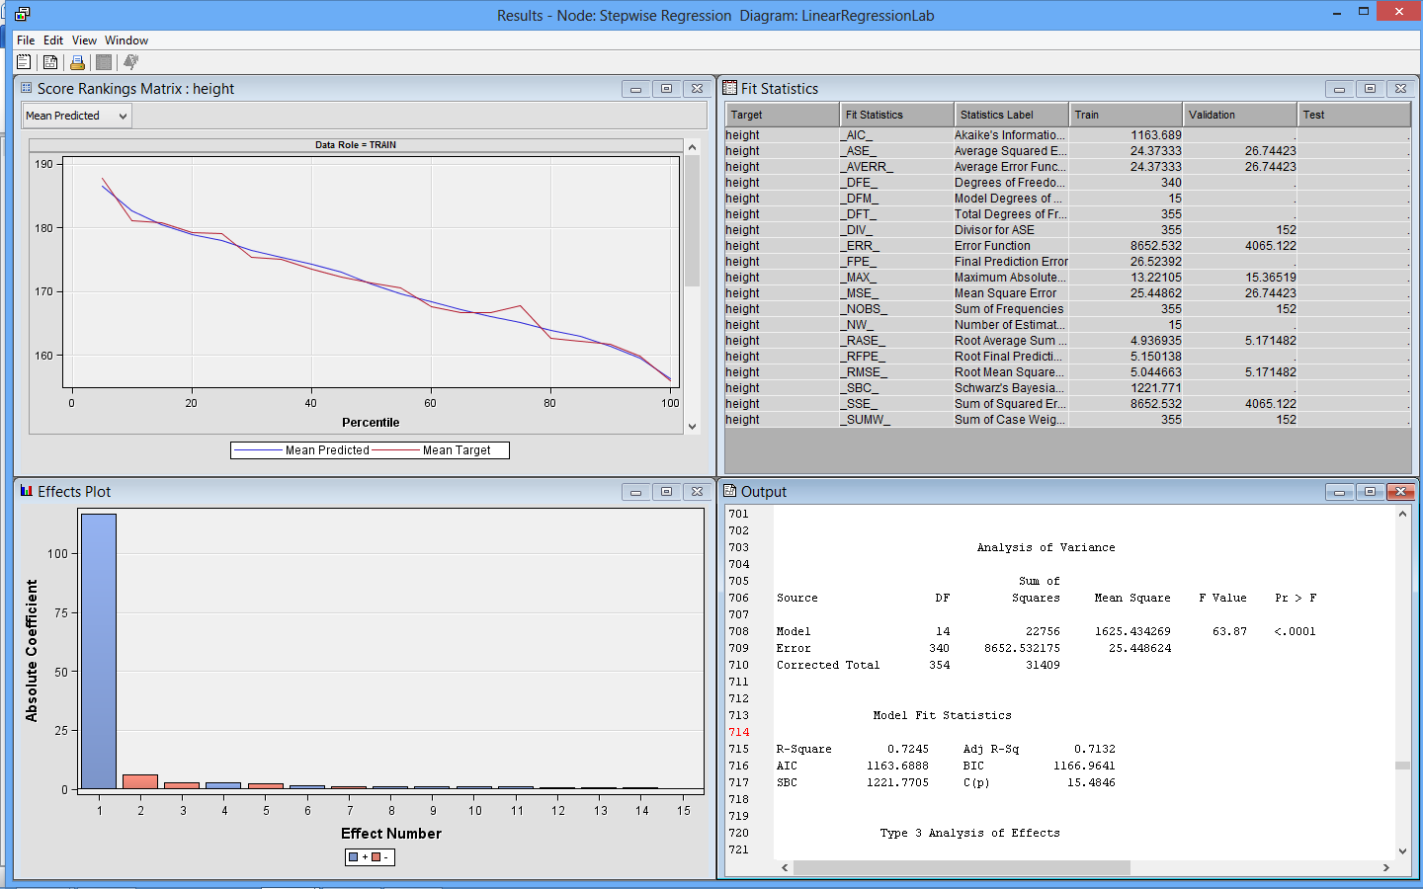
Regression Node Model Results for Linear Regression
100*Adjusted R² Value – Gives proportion of variation in target Y explained by input Xs

Slide 13
R² vs. Adjusted R²
Adjusted R² takes the degrees of freedom of the error and total into account.
In practice, R² will only increase or stay the same when adding variables to the model
Adjusted R² accounts for this so that adding variables to the model can decrease Adjusted R²
  This prevents overfitting of models with too many X variables to explain the Y
  Usually for problems we will see, R² and Adjusted R² will be close

Slide 14
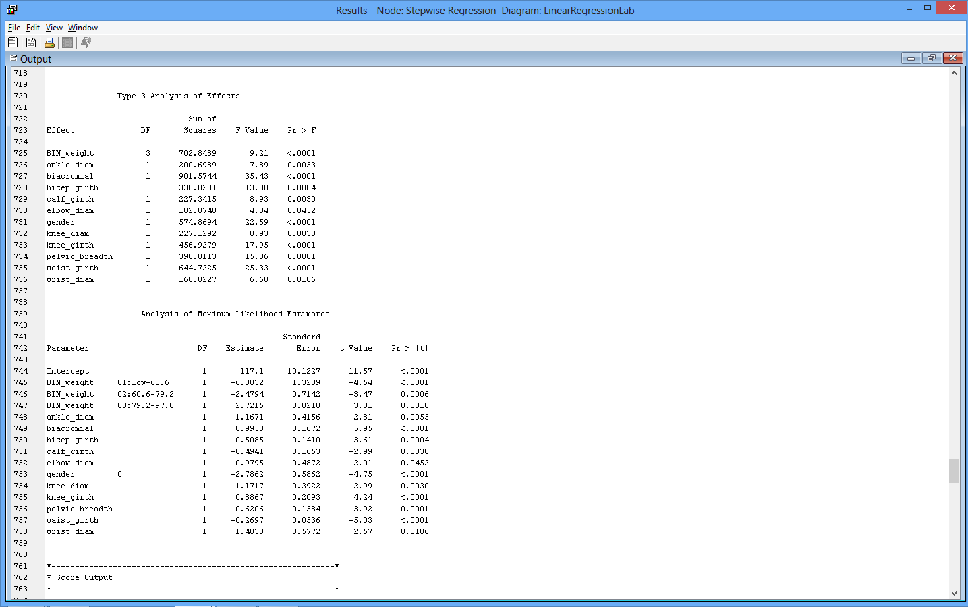
Regression Node Model Results for Linear Regression
Low Signficance (p-value <0.05) indicates input has significant linear relationship with dependent y target variable

Slide 15
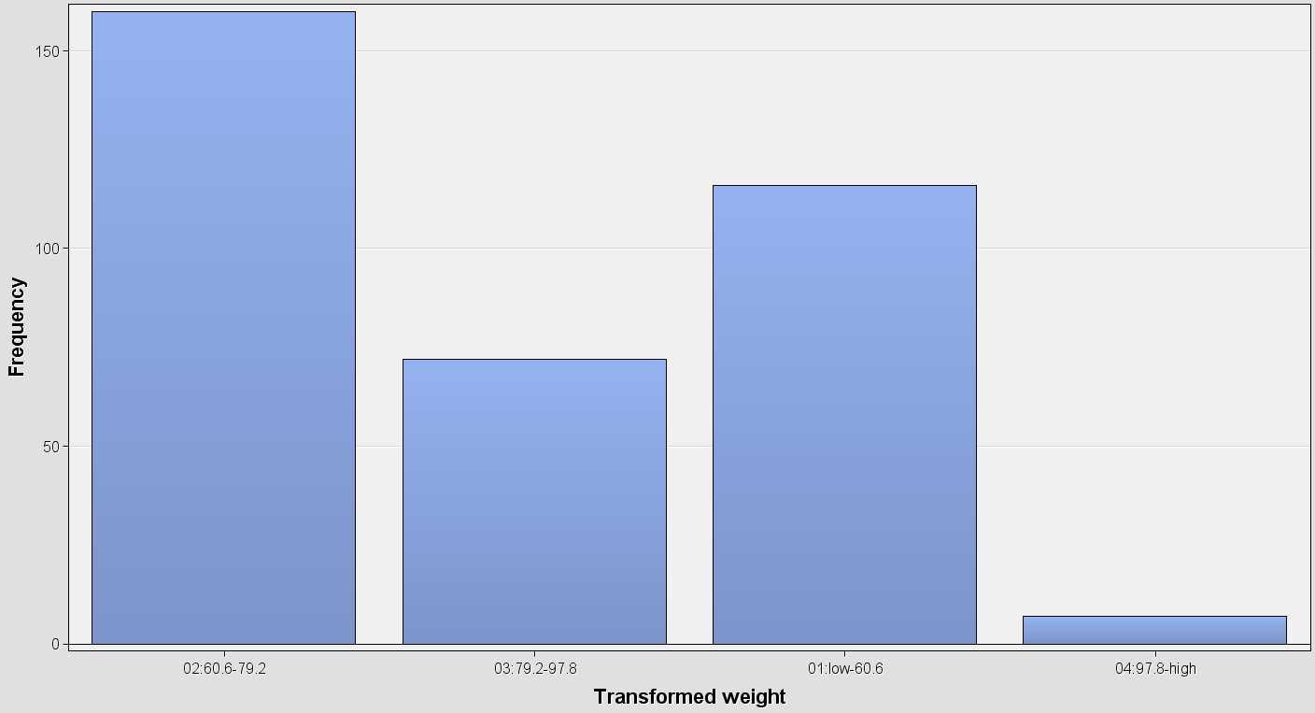
Weight Bins for this regression example where the target is height

Slide 16
Regression Node Model Results for Linear Regression
Low Sig. (p-value) indicates coeffecient has significant linear relationship with dependent y variable
Linear Regression Coefficient
Gender = 0 (female) decreases
Height by 2.7862 cm compared
to males
Every unit increase of
wrist diameter
increases
height by 1.4830 cm

Slide 17




Predictor Error Measures –
Regression Node Results Window
Measure predictor accuracy: measure how far off the predicted value is from the actual known value
Loss function: measures the error betw. y_{i} and the predicted value y_{i}’
  Absolute error: | y_{i} – y_{i}’|
  Squared error: (y_{i} – y_{i}’)²
Test error (generalization error): the average loss over the test set
  Mean absolute error: Mean squared error:
  Relative absolute error: Relative squared error:
  The mean squared-error exaggerates the presence of outliers
  Popularly use (square) root mean-square error, similarly, root relative squared error

Slide 18
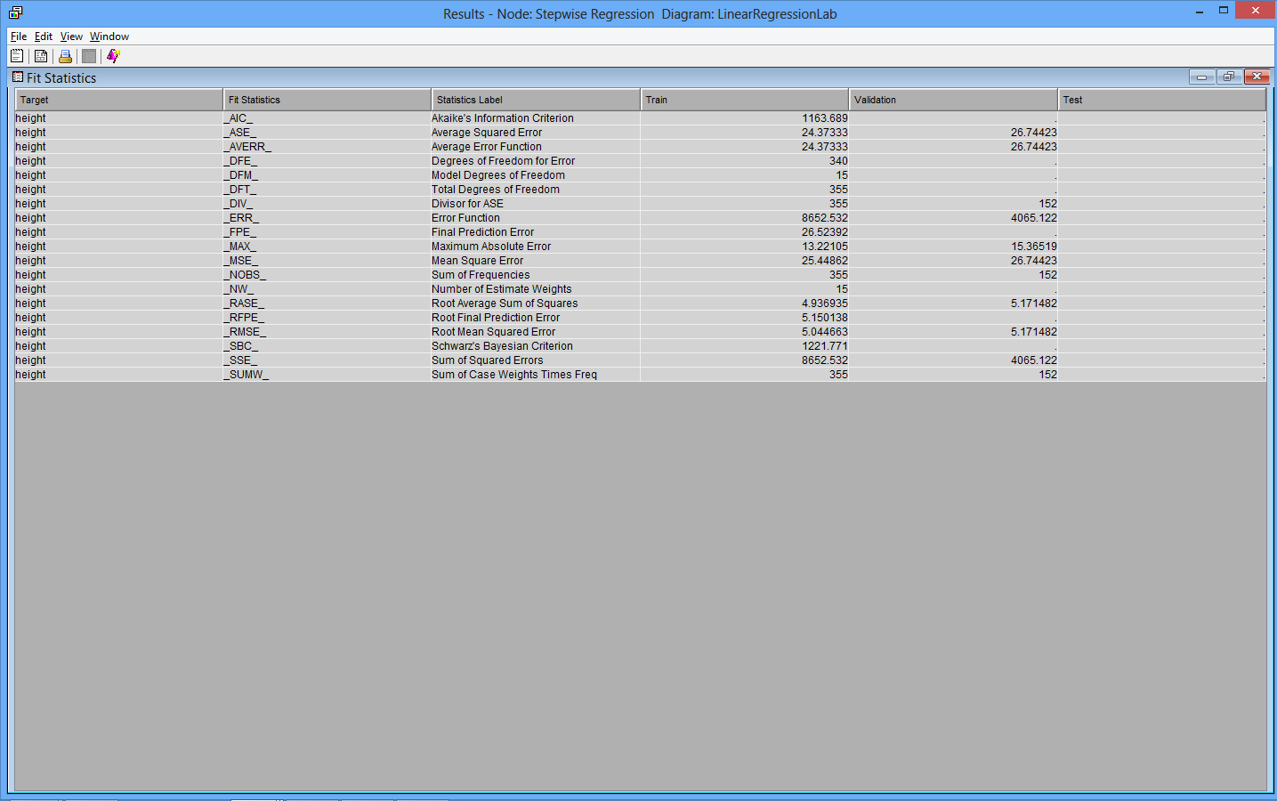
Regression Node Results Fit Statistics Window
There are many statistics to evaluate Linear Regression model performance. For our class, we will use Root Mean Square Error unless otherwise noted.
If the error is much higher on the validation data compared to the training data, this is an indication your model has overfit the training data

